Slide 1
Missed AWT Interval Report
Automating the weekly scan for missed 2-minute wait time targets
Prepared by Momna Ali

Slide 2
THE GOAL
Nobody should have to hunt for missed intervals by hand
1
The problem
Every week, WFM manually scans hundreds of half-hour intervals to find where the 2-minute average wait time (AWT) target was missed.
2
Where it came from
Raised directly in the Care Weekly Service Level Performance review on 8/11 - Jonathon and Momna were asked to build an automated view of every interval that misses the target.
3
What good looks like
A report that updates itself the moment new weekly data is entered - no manual scanning, no copy-pasting, nothing for WFM to build.

Slide 3
HOW IT WORKS
Plain-English walkthrough of the automation
1
Reads the same data WFM already enters
Uses the existing Data Input tab - the half-hour interval data WFM pastes in every week. Nothing new to fill out.
2
Filters to misses only
Pulls out every interval where AWT Minutes exceeded 2:00 - the same threshold already defined in the Criteria Matrix.
3
Grades how bad each miss was
Labels each one Minor (2:01-3:00), Moderate (3:01-5:00), or Severe (over 5:00) - using the severity bands already agreed for the weekly narrative.
4
Refreshes on its own
Built entirely with formulas, not a script. When WFM pastes next week's numbers into Data Input, the list updates automatically - nothing to run.

Slide 4
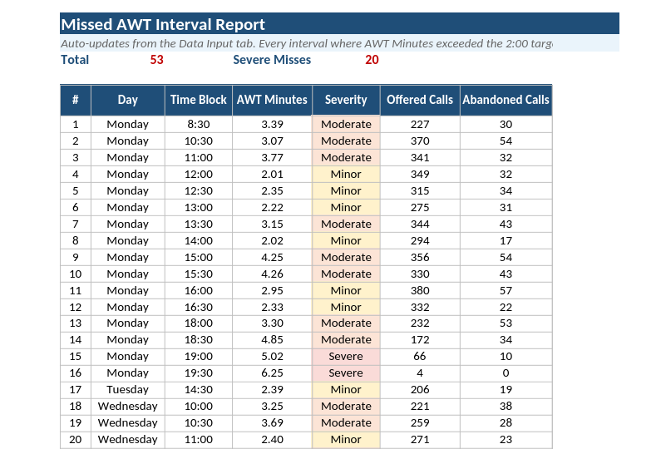
THE OUTPUT
A live, filtered list of misses
How to read it
Each row is one half-hour interval that missed the 2-minute target
Color shows severity at a glance - amber (Minor), orange (Moderate), red (Severe)
Offered and Abandoned Calls sit right next to each miss, so context is visible without opening Data Input
Total Missed and Severe Misses counts sit at the top, updating live

Slide 5
THIS WEEK'S NUMBERS
Week of 8/2 - 8/8: what the report is already showing
53 of 138 intervals missed the target
That's about 2 in 5 half-hour blocks this week - roughly matching what was already being found by hand.
20 misses were Severe (over 5 minutes)
More than a third of all misses were the worst category - concentrated Wednesday evening and Thursday morning.
Worst single miss: 17.8 minutes
Wednesday 7:30 PM - the same spike already flagged in the existing weekly narrative.

Slide 6
QUESTIONS FOR JONATHON
A couple of decisions worth confirming
Should Primary Driver / Action Taken become live weekly inputs?
Right now those columns pull from Data Input, which is blank per-interval. If WFM starts tagging a driver/action per missed interval, the report will show it automatically - worth deciding if that's the workflow going forward.
Does this replace or sit alongside the existing Daily Exception Summary?
The Weekly Narrative tab already summarizes misses by day. This new tab shows every individual interval. Useful to confirm both stay, since they answer different questions.
Should this same automation extend to other criteria in the matrix?
Abandonment >7%, forecast variance, and occupancy could get the same treatment if this approach is a good fit.

Slide 7
NEXT STEPS
Share the workbook with Jonathon for review
Confirm the two open questions above before it becomes the standard weekly view
Once confirmed, retire the manual weekly scan

